Slide 1
Toronto Neighborhoods
Harsimran Kaur

Slide 2
Introduction
Toronto Neighborhoods is project which suggests its users the type of neighbourhoods they would prefer according to their choice of venues in the neighborhood.

Slide 3
Data
List of neighborhoods : Webscraped from wikipedia
Latitude and longitude : Python Geocoder Library
List of common Venues : Foursquare API

Slide 4
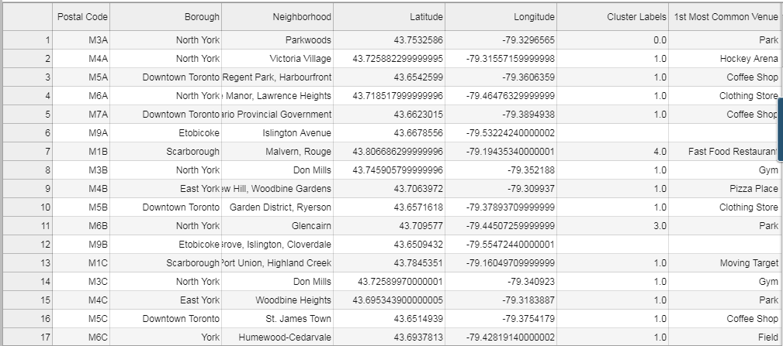

Slide 5
Methodology
Collect and clean the data from various sources
Visualize the data using K-means and Folium Library
Input user preferences and output the list of suitable neighborhoods accordingly

Slide 6
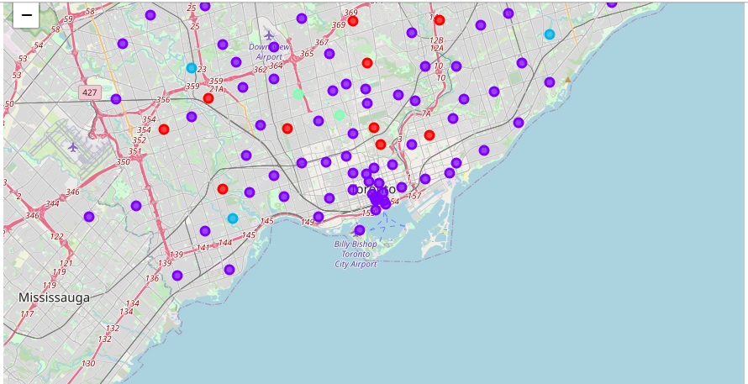
Screenshots

Slide 7
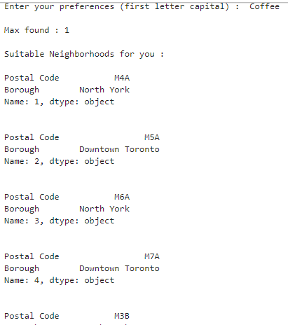
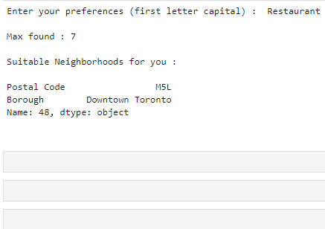

Slide 8
Conclusion
Successful implementation of Python libraries
Utilization of FourSquare API
Suggested the users with the best suitable choice of neighborhood

Slide 9
Future Scope
Ask user about the least preferred choices in the neighborhood
Study the previous preferences of the users in order to choose the similar neighborhoods.

Slide 10
Thank You :)

